Slide 1
True Enterprise RPA
February 2019

Slide 2

We took all this mundane work out and the guys could then focus on the next thing without having to increase headcount, without having to hire new staff, and all the recruitment cost and everything else that goes into that.
At Autodesk, we want our customers to have a frictionless experience accessing and using our technology. Most importantly, the tools help us do our jobs more effectively, so we can focus on the best experience for our customers.
Brendan MacDonald
Director of Customer Compliance Operations, Ladbrokes Coral Group
Scott Herren
Chief Financial Officer
Notes:
The view from customers…
More customer stories available here: https://uipath.atlassian.net/wiki/spaces/STBX/pages/1434650119/Customer+Stories+Use+Case+Slides+Video+Testimonials
Use case deck: https://docs.google.com/presentation/d/113KPRDuj6_-oKH9k8IXFjy1De9WVqliq0fQqyeEA2r4/edit?pli=1

Slide 3

Users of Enterprise RPA consider ease of software and robot maintenance, security and scalability to be its most important features. Integrated cognitive and machine learning for processing unstructured data is also important, as is the availability of robot operational analytics. RPA is a journey and the richness of the software speeds up that journey. By 2021, there will be as many attended robots in customer service as there are people; about 3 million.
Notes:
Source: https://drive.google.com/drive/u/0/folders/1z0QLRm_imHL2Ky2TmIHFqx1meCocybF8

Slide 4

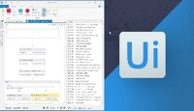
Digital Transformation Outcomes are Now Real and Immediate
ROBOTIC PROCESS AUTOMATION
Record, program, execute and share!
CUSTOMER OUTCOMES
Accelerate Benefits from Digital Transformation
Improve Customer Satisfaction
Reduce Compliance Cost & Risk
Increase Employee Satisfaction & Engagement

Slide 5
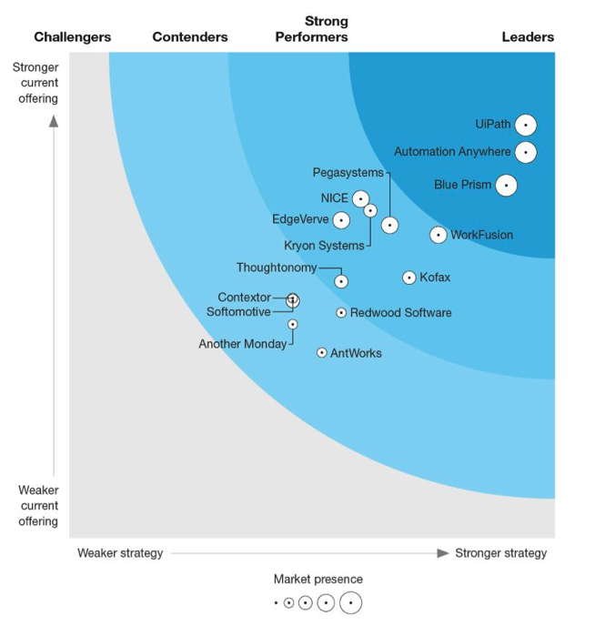
The Forrester Wave Leader
“UiPath is a Leader with shared services and ease of bot design. UiPath is one of the fastest growing RPA vendors.
The platform easily handles attended robots developed by employees as well as unattended robots that can handle large-scale processing.
Customers noted its deployment flexibility.”
Source: Forrester Research, Forrester Wave for Robotic Process Automation, June 2018
Notes:
Everything we’re talking about today is important to start out with a proof point
In June 2018 the 2nd Forrester Wave for process automation came out and UiPath is clearly on top
Craig Le Clair (analyst at Forrester) covers the industry like no one else in this community
His first wave was the most downloaded document in all of Forrester in 2017
That wave UiPath was a leader as well
In this one we are the undisputed best
Forrester Wave is available for download on our website any time
Is a great indication of how far UiPath has come
Latest Forrester Wave moved UiPath in to the undisputed leader position
UiPath named the RPA provider with the strongest current offering and highest market presence
------- guide - or reinforce existing - audience expectations for what an RPA platform should provide - using these Forrester findings.
https://drive.google.com/drive/u/0/search?q=the%20new%20frontier%20of%20automation
Our platform will meet those expectations, and the Forrester findings establish our capabilities in an objective manner. Plus, most customers are curious about what other companies are thinking.

Slide 6
Our top five platform priorities
Open
Built in extensibility, open to share, use, learn
Rapid
Proven to deliver automation 40% faster
AI
Robots are learning new skills to drive more complex and cognitive automations
Scale
Deploy and manage at enterprise scale
Trust
Defense-grade security and auditing
Loved by Users, Valued by Business, Trusted by IT

Slide 7
Built in extensibility
Strategic Technologies
Embedded best-of-breed technologies speed our innovation
Deep Rest API
Truly dynamic integration with your existing infrastructure
100s of Activities
Built-in, customizable, shareable — Activities are the building blocks
Share & Extend
Reusable Libraries and a direct integration with the Go! Marketplace
Notes:
Pillars in greater detail
Open – Built in extensibility
Ability within Studio to quickly have access to preconfigured activities
Activities: the building blocks of process automation
Quickly integrate with Excel doc, IBM Watson, etc.
Can custom build activities too and upload them if you want
Automations (the files that describe your workflows that robots execute) are open source that can be shared and extended if you want
Speeds implementations of common functions
Philosophy of being able to share and collab
None of our competitors have a community focus
Powerful API that allows integration with existing infrastructure
Robots can be triggered through UiPath software and run through existing systems
API built deep into product
Some of our competitors just added API, we’ve had it for years
Gives you a lot of power and control in our software
We include Strategic technologies in our platform where it makes sense
We’re not reinventing the wheel, but giving you blocks to work on
Our workflow engine is based on Windows workflow foundation
Provide and unstructured data store called Elastic Search
Very intelligent OCR
We include technology from ABBYY
Hundreds of Activities – drag and drop native integrations – enable fast and sophisticated automation development
Deep Rest API for truly dynamic integration with your existing infrastructure, such as ERP or BPM
Easily share and extend automations, invoke code to leverage any ML model with Python, and apply any AI algorithm to make your process smarter
Embedded strategic technologies enable faster innovation, such as Google and ABBYY for OCR, and Elasticsearch for unstructured data storage

Slide 8
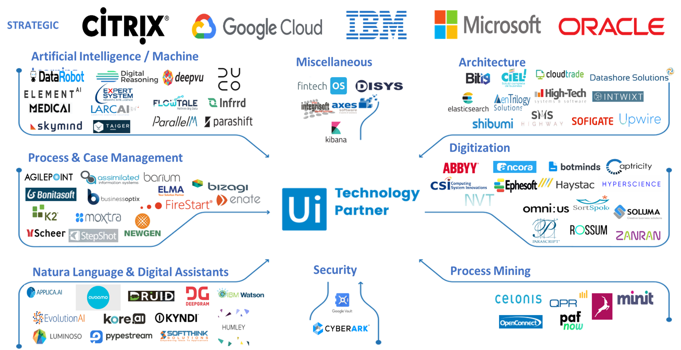
Open to a growing ecosystem of best-of-breed capabilities
Flexible architecture frees robots to execute any process with speed and 100% accuracy
Supports both attended and unattended robots on a single enterprise platform
Multi-tenancy allows privacy & security for many users in a single robot management (UiPath Orchestrator) instance
High-density robotics enables many robots to run on a single VM, on-premises or in the cloud.
Intelligent scheduling of process automations optimizes the digital workforce and operational performance.
Rest APIs enable collaborative integration with BPM (e.g. Oracle), DMS (e.g. IBM) and new AI technologies

Slide 9
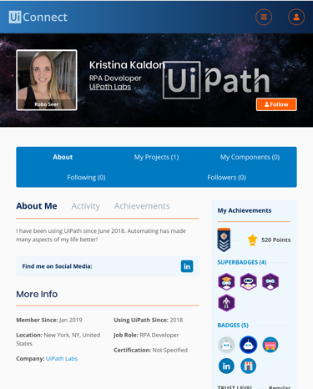
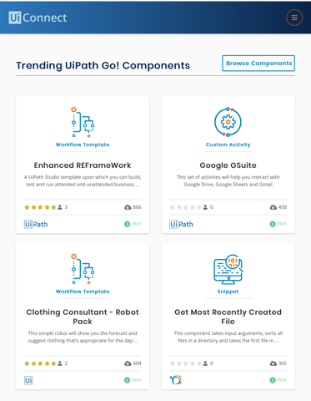
Open to Share
UiPath Connect!
The destination of choice for RPA developers to find collaborators for projects, learn, and build a living resume
UiPath Go!
The world’s first RPA Marketplace directly integrated with an RPA Platform, Go! offers:
Accelerated ROI and allows you to do more with RPA through secure and trusted components
Machine learning models, custom activities, and more for your business processes

Slide 10


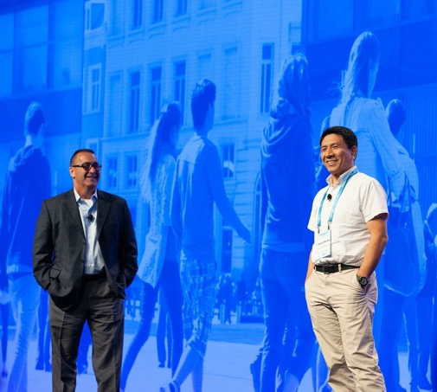
Open to Use. Open to Learn.
1M students by 2020
300K Community downloads
250K Academy trainees
240K Forum posts
Academic Alliance
Through partnerships with hundreds of universities, nonprofits, and governments around the world, UiPath is committed to providing education resources for an Automation First world
Notes:
UiPath employees are passionate about democratizing RPA
Making it easy to build automations that compliment what you do
Our community has had over 300,000 downloads of our software
We offer a community version for small companies and a free trial for medium and large companies
Very active community on forum- anyone can have access
17,000 active members
Academy is our commitment to helping you build skills and earn diplomas of accreditation for your ability to use UiPath software
Gone through 3 iterations
Over 100,000 enrolled
“The Largest and Most Skilled RPA Developer Community”
With diplomas at 1,000/month and growing, our customers have an expanding talent pool to draw from and training resources to offer their own employees.

Slide 11
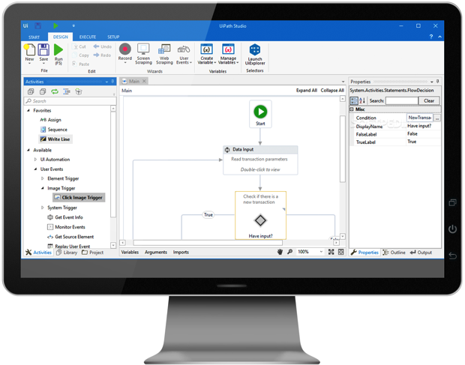
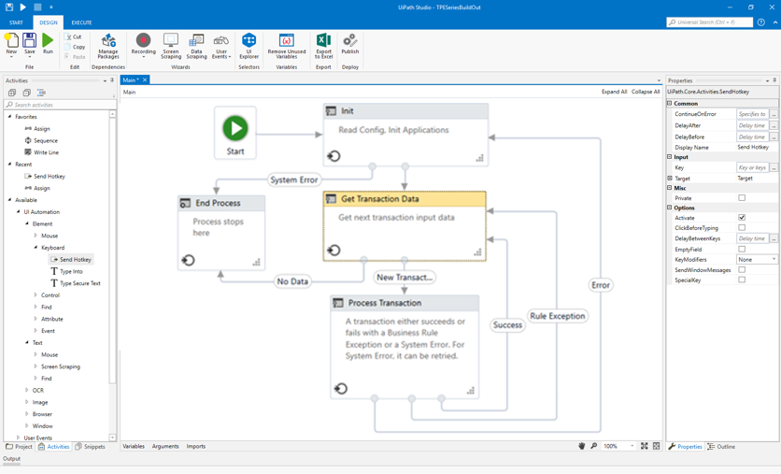
Faster automation design and deployment
Visual Designer Highly intuitive, powerful process mapping
Activities library
Automate the applications you rely on including Microsoft Office, Gsuite and
Line of business applications.
Collaborative automation Share components across your organization or even in the Go! Marketplace
Centralized insights and management
Pre-built Analytics and Reporting with Kibana and Tableau
Deployment configuration and upgrade tools
Notes:
Rapid Results:
We see a 40% faster automation design and deployment than our competitors
Many of our competitors are still very programming intensive in their design tools
Ours are very visual, easy to build automation in minutes
Drag and drop, recorder, etc.
Our Citrix automation is known as one of the best in the industry
8-10 times faster at automating Citrix than our competitors
Desktop, Web & Citrix recorders capture user actions on the screen
Re-usable component libraries accelerate automation development and maintenance
300+ drag & drop process activities come out-of-the box. A library stores new activities for reuse
Exceptional process automation speed: Citrix automation – 8-10X faster than competitors; desktop/web applications – 40% faster.
Native Citrix Automation: Citrix automations are now performed natively without the need for OCR making Citrix automation faster and more reliable.
Orchestrator automatically manages & deploys new automations to the virtual workforce
Unrivaled computer vision does real time, auto-adjustments for screen changes during robot activity, reducing downtimes & maintenance
Orchestrator automatically licenses, provisions and deploys new robots
Source: Various PoCs during 2017 with System Integrators

Slide 12



Faster design and implementation equals faster outcomes
Operates in all customer environments
Integrates with your existing technology stack
Reporting built in Analytics provided by Tableau and Kibana integrations
API integrations to key applications including SAP, Oracle, Dynamics, Office 365, ServiceNow, Remedy
Native support for Citrix XenApp
Localization
Background themes
Developer-friendly debugging
Recorders create workflows from user actions
Reuse pre-built automation components
Easy to use
Integrations
Fast development
Connect to Community
User Enablement
Reducing technical skill dependencies and increasing ease-of-use.
Fast implementation and deployment of automations.
Visually document business process rules
Assigned customer success managers to support rapid deployment
Partner ecosystem to fill augment skills and technology
Download, share, and reuse automation accelerators from Go!
Complimentary and comprehensive training in Academy
Trial versions to accelerate usage
Access to forum for speedy issue resolution
Notes:
We look at the path to making it easy to use UiPath software
Increasing user enablement
Providing pre-built integrations
Decreasing the complexity

Slide 13

Value delivered to the customer
Boost
Revenue
Accelerate
ROI
“RPA with UiPath was not a cost play. It was more around quality, speed of doing business, compliance. Really getting the benefits out of the workforce that we didn't and couldn't do before.”
— Jairo Quiros, VP, Global Shared Services and RPA CoE Lead
Payback periods in
<6 months
Higher Revenue
Rapid deployment
Faster TTM
Competitive advantage
Accelerated ROI
Lower Cost
Implementation cost
Development cost
Training costs
Robots maintenance cost
Support costs
Reduced Risk
More predictable projects
Lower project failures
Less compliance and competitive risk
Notes:
Increased Revenue:
Rapid deployment of RPA projects
Faster time to market
Competitive advantage
Accelerated ROI on RPA investments
Decreased Costs
Decreased end-to-end implementation cost with best in-class IDE – Studio
Decreased development cost with Go!, the RPA marketplace
Decreased training costs with complimentary Academy training
Decreased digital workforce maintenance costs with Orchestrator
Decreased support, development, triaging costs with global support and developer’s Forum
Reduced Risk
Reduce the risk of an over-budget/over-schedule project with pre-built and integrated components
Reduce the risk of project failure with UiPath Global Partner Ecosystem leveraging local resources, Global Support, UiPath Community, and easy-to-find talent
Lower compliance and competitive risk with the ability to rapidly respond to regulatory, business and industry changes

Slide 14
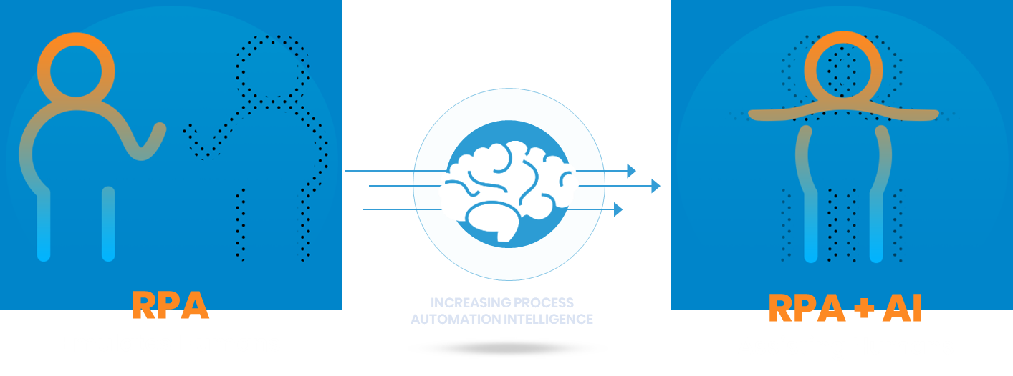
RPA is Continually Evolving – Robots are Learning New Skills
Rules-Based, Repetitive Tasks
with Computer Vision
Increasingly Complex, Cognitive Tasks
Notes:
Because Robots are learning new skills, RPA is continuously evolving.
This evolution started with traditional RPA which has enabled customers to automate rules-based, repetitive tasks. In the case of UiPath, one of our key early differentiators was our innovations in computer vision.
We are now taking that to the next level, with increasingly sophisticated Pragmatic AI capabilities to enable automation of increasingly complex, cognitive tasks.

Slide 15
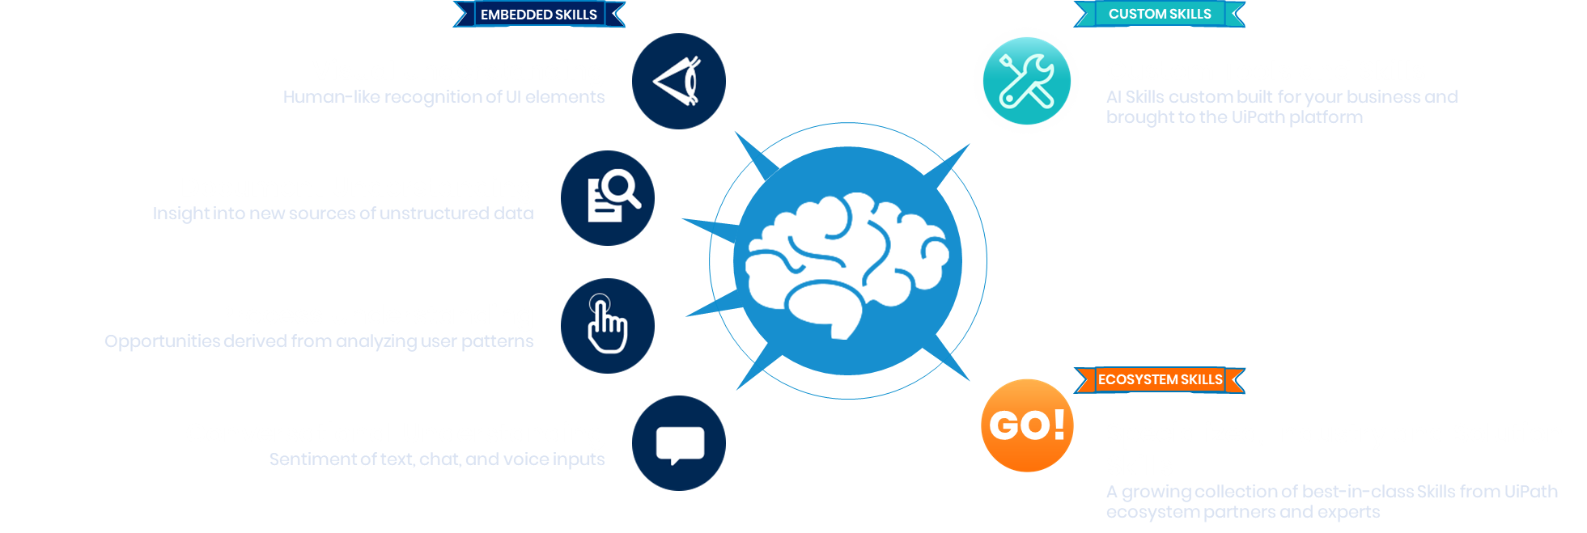
A Robust and Evolving Skillset Keeps Your Robot Relevant
Notes:
So, how is UiPath delivering Pragmatic AI? First, we have a set of Embedded Skills we are building in-house by the UiPath AI development team.
These capabilities are across four key areas:
First, Visual Understanding:
AI that automatically identifies and completes UI elements (menus, logins, scrolling, etc)
Lowers the need for technical selectors or APIs
Maintains automation robustness even after software upgrades
Second, Document Understanding:
Including template-less processing of receipts and expenses
Invoice extraction and processing
Email classification for service centers
Third, Conversational Understanding:
Analyze sentiment of text, chat, and voice inputs
Classify inputs in order to automatically route them to the right team
Execute requests and actions from Chatbots and Voice Assistants
Fourth, Process Understanding:
Visually learns from user behavior
Observe inter-departmental patterns and processes
Automatically identify new automation and efficiency opportunities
We think that these capabilities solve the most common and urgent customer needs, so it is where we are focusing our investments internally.
However, we also recognize that there are times when customers will have more focused automation needs, such as industry, solution or highly specialized needs.
To solve this, we are also delivering over 60 additional AI skills through integrations with our AI technology partners.
Finally, there are going to be certain situations where a customer has a challenge, and in many cases a data set, uniquely specific to their business.
In these cases, both embedded skills and ecosystem skills are simply not specific enough to address these particular challenges.
So, we also enable our customers to connect custom skills and models that have been created by their own data science teams, directly to their automation workflows.
In summary, UiPath is delivering the broadest and deepest set of AI skills of any RPA provider, and we are just getting started.
We will deliver out of the box embedded AI skills, enable a wide range of specialized AI skills through our AI partner integrations, and enable our customers to directly connect custom AI skills to truly deliver on our Automation First vision.

Slide 16
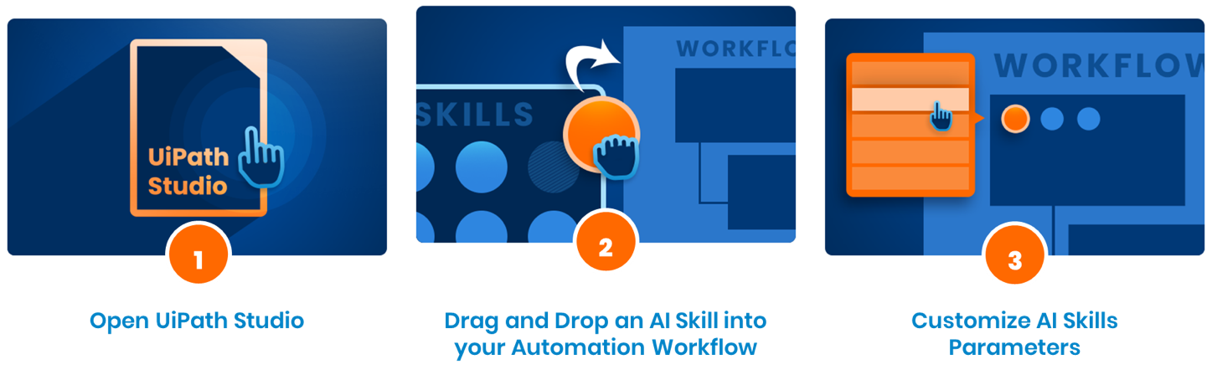
Drag & Drop AI: Add skills to your automations in 3 easy steps
Add your AI Skills directly in UiPath Studio.
Utilize AI skills which are embedded out-of-the-box, download from Go!, or import your own.
No technical skills required. Updates can be made by analysts and business users.
Notes:
Finally, UiPath enables the ability to drag and drop these skills directly into RPA automations.

Slide 17
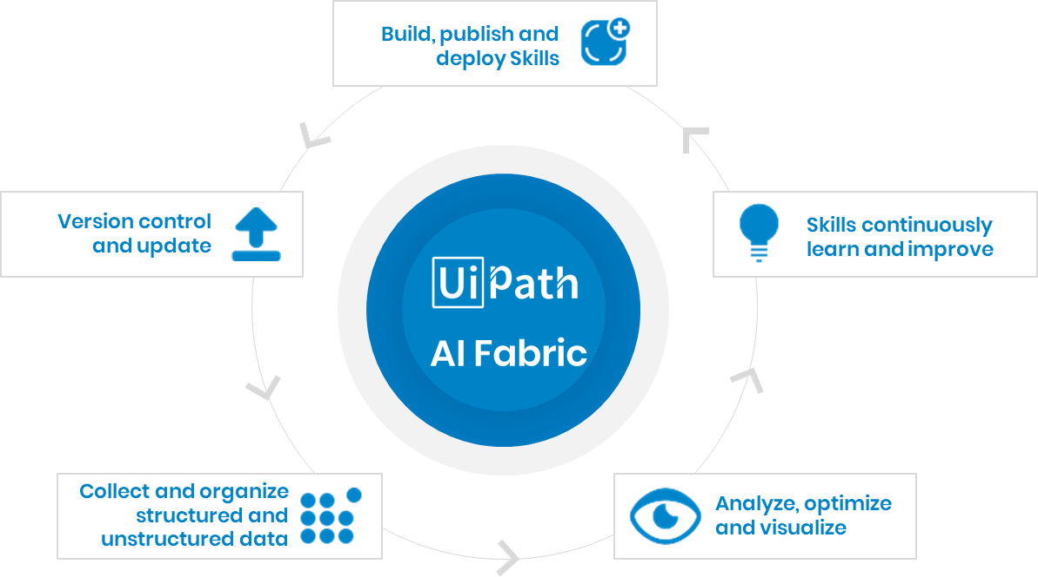
The AI Fabric Vision Directly infused into UiPath’s platform
Notes:
Our AI Fabric vision is to enable the ability to manage end to end ML pipeline creation, including building new skills, managing and deploying those skills, collecting new data and improving the skills over time, and analyzing, optimizing and visualizing outcomes to measure and validate results..

Slide 18
Prepare to manage and scale your digital workforce
30,000+ Robots
Managed by a Single Orchestrator, On-Premises or in the Cloud
Flexible Robot Architecture
Support for mixed attended, unattended, assigned, floating and high density deployments
Multi-tenancy
For enterprise-wide operations
Maximum efficiency
Concurrent robotic activity at scale
Localization
Japanese, Russian, French and available today with many more regions coming soon
Notes:
Scalability
Critical
We’ve tested over 30,000 robots in a single orchestrator
Run our robots on premises or in cloud
A few things that are critical
Multi-tenancy
Ability to have multiple operations as you expand RPA
Concurrent Robotic Activity
To have a lot of robots deployed, but only have to use a few robots doing many tasks
Kibana and Tableau
Being able to control a lot of robots in there visualization tools
THE UIPATH DIFFERENCE
Flexible architecture frees robots to execute any process with speed and 100% accuracy
Supports both attended and unattended robots on a single enterprise platform
Multi-tenancy allows privacy & security for many users in a single robot management (UiPath Orchestrator) instance
High-density robotics enables many robots to run on a single VM, on-premises or in the cloud
Intelligent scheduling of process automations optimizes the digital workforce and operational performance

Slide 19

Prepare to manage and scale your digital workforce
Save Millions of Hours.
“We expect over 1 million hours of capacity to be generated by the end of this fiscal year and more than 3 million hours in the next three years.”
Higher Revenue
Automation at scale accelerates the ROI by deploying in multiple BUs, across multiple geographies
Lower Cost
Full cost transparency
Decreased development costs
Lowers infrastructure cost
Supports all CoE and governance models
Lowers maintenance costs
Reduced Risk
Lowers the risk of global project failure
Reduces compliance risk
“DevOps” approach: helps control deployments and dependencies
Lowers the risk of configuration delays
Notes:
With huge scale operations you save millions of hours
Adding massive capacity
When you zoom out on the digital workforce it is making a huge difference
OUTCOMES
UiPath Robots give complete automation solution coverage to cover all front-office and back-office requirements and opportunities
Orchestrator scales & prioritizes work queues & robots on-demand to meet SLAs
Platform design efficiently utilizes customer infrastructure: cloud, premises datacenters & desktops
Platform able to collaboratively integrate with existing BPM & ERP systems

Slide 20
RPA Better Business Process Execution
Subject | Pre-RPA | Post-RPA | Benefits
Scope of audit | <10% of volume | ~100% based on terms | Compliance
Process design/execution | High variability | Improved consistency | Standardization
Ecosystem | Intrusive automation | UI-based, code-free automation | Increased speed Decreased risk
Manual errors | Typing-to-timing errors | Human-robot collaboration | Accuracy
UiPath -> Improved IT Governance, Risk and Compliance
Process Security
Controls for newly
Development
Secure development of robots
Platform
Secure environment for robots
Data Security
automated process.
E.g. Segregation of duties
E.g. change management
E.g., Credential storage
Transaction information never stored.
E.g. Navigate worry-free through systems
Notes:
UiPath’s technology enables security to get better, faster, and cover more areas than ever before
Scope of audit
Pre-RPA - Standard audit coverage on average is <10% of volume for systems & financial balances​
Post-RPA - Audit coverage can be 100% based on automations introduced & overall goals​
Process design/execution
Pre-RPA - Multiple processes across geographies for same activity invoicing, server creation, etc.…
Post-RPA - Standardized single process by a robot that can be modified based on a controlled environment​
Ecosystem
Pre-RPA - Manual interfaces to create automations via middleware, risk to servers, access, & systems​
Post-RPA - Robot that utilizes UI elements to interact with systems … requires no coding changes in systems
Manual Error
Pre-RPA - Human input processes can contain multiple manual errors from typing to timing​
Post-RPA - Attended automation can use humans while controlling what is inputted into the system​

Slide 21







Defense-grade security and compliance
Standards and Compliance
Identity and Access Management
UiPath is certified for
Information security Management System ISO 27001:2013
Quality management system: 9001:2008
Our products are designed to make compliance with industry standards and regulations easy
SOX
PCI-DSS
GDPR
HIPAA
NIST
Support for SAML based Multi-factor authentication
Support for Smart Card authentication
Integration with CyberArk for secure secret storage and retrieval
Application managed fine grained role based access control
Data Security
Application Security
At Rest: AES 256 bit data encryption for sensitive data such as SSN etc.
In-Transit: SSL and encrypted channels
Veracode certified
Third Party and Open Source Code Vulnerability Management
Continuous Internal and External Pen Testing
Adherence to Top 10 OWASP, CWE/SANS Top 25 and CERT guidance

Slide 22

Value delivered to the customer
“UiPath underwent security testing, including conducting manual and automated web application security testing on NASA’s high-risk applications. Using a combination of automated and manual testing techniques, UiPath software passed the NIST 800:53 revision 4 standards.”
Higher Revenue
100% Compliance
Improved customer satisfaction
Higher results
Improved employee contribution
Lower Cost
Non-compliance costs
Cost of manual labor
Cost of poor quality
Cost of business operation
Cost of implementation
Reduced Risk
Early fraud detection
Non-compliant behavior
Identity theft : MFA
Data leakage/breach
Multiple access control management
Notes:
Increased revenue
protect revenue and customer relationship by ensuring 100% compliance
Improved customer satisfaction with increased reporting accuracy
Higher results generated as reporting is quick, compliant, and error-free
Employees focus on higher value task contributing to higher revenue stream
Decreased cost
avoid fines and damage to brand reputation due to non-compliance
Reduce cost of manual labor to monitor and manage complex and voluminous data
Reduce cost of poor quality by cutting down on manual errors
Business operation cost decreases with increased compliance, error-free result
Reduce cost of implementation to adjust to change in policy/process
Reduced risk
Early detection of fraud (internal and external actors)
Reduces non-compliant employee behavior with immediate desktop alert
Multi-factor authentication and use of soft tokens
Role-based access control reduces risk of data leakage as authorized people have access to data
Simple HTTP protocol framework reduces risk of managing multiple server ports and access controls

Slide 23
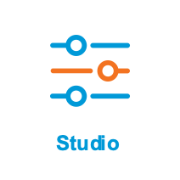
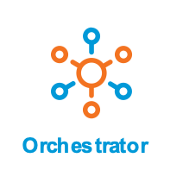
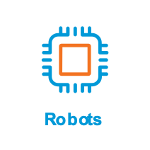
The UiPath Enterprise RPA Platform
UiPath Studio
UiPath Orchestrator
UiPath Robots
EXECUTE
Big Scale
DEPLOY
MONITOR
Digitize your process
Manage and Secure
Deploy and scale
Easily create automations in a visual editor across various software applications
Control, monitor, and analyze the performance of your virtual workforce
Your attended and unattended robots
Notes:
UiPath Enterprise RPA Platform consists of three core components, Studio, Orchestrator, and Robots.
Studio - is a widely adopted automation designing tool with over 300K users worldwide. Studio is the best in-class Integrated Development Environment (IDE) offering ease-of-use, high degree of flexibility, allowing a user to compose automation workflow for business process of any complexity level. Studio is an intuitive digital canvas accommodating users with varied skillset to build automation workflow using several methods such as drag-drop readymade components, custom recorders, using supported programming languages etc.
Orchestrator - is a central web-based control system which helps an administrator to securely manage, control, and schedule enterprise-wide digital workforce. Orchestrator has several features but it’s 4 main capabilities include:
Scalable Automation - Deploy, control and monitor your UiPath Robots at any scale
Business Insights - Deep visibility into performance, with powerful real time analytics.
Enterprise Protection - Comply with security and regulatory requirements
Flexible Management - Deployment choice, modern admin experiences and an open platform
Robot - is the execution agent and the fundamental component of the platform. Robot executes the workflow designed in Studio according to the schedule defined in Orchestrator or by the trigger command in robot tray/command line. UiPath’s versatile robots are compatible with various systems and hence can automate processes on systems such as Citrix, desktop, web, SAP, mainframe, and several other legacy systems.
There are two kinds of robots:
Attended - works on the same workstation as a human user does and is usually triggered by the user through their actions (user events) or when the robot needs direction from the user. ​Attended robots are best fit for efficiency enhancements activities.​
Unattended - runs in background or in virtual environments and can automate any number of processes.

Slide 24





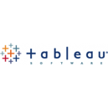







Start with an Easy-to-Use Designer
UiPath Studio
Design your automation visually, with low code
Use built-in recorder, drag & drop widgets and best practice templates to model your robotic processes fast
Over 300 pre-built activities

Slide 25

Prepare to manage, control and secure your automations
UiPath Orchestrator
Control, manage and monitor your entire robotic workforce
Our browser-based server application centralizes in one secure place your entire enterprise operation.
Robot work management features
Transaction Queue
Intelligent Scheduling
Enhanced Exception Handling
Dashboards & Reporting
API Integration
SECURITY AND GOVERNANCE
Access Control
Credential Management
Auditing
Encryption

Slide 26

Deploy Robots for Speed, Scalability and Efficiency
UiPath Robots
Execute automations with perfect accuracy from a desktop, data center or the Cloud
Take over and execute all your processes automatically with perfect accuracy.
Robot types
Attended Robots
Robots that interact with humans on a desktop, often in the ”front-office”
Unattended Robots
Robots that execute an entire human function, often in the “back-office”
Hybrid RPA
Automations that combine both attended and unattended tasks

Slide 27


DEMO
Notes:
Demo:
Show one of the demos here

Slide 28

True Enterprise RPA
UiPath Breakthroughs
Computer Vision
Perfectly emulates human worker repetitive tasks through the User Interface
Acts as the hands and eyes… not the brain
No coffee breaks
“Drag and Drop” Easy-to-Use Designer
Built-in recorder
Sequences support linear processes
Use Flowcharts for complex business logic
State machines support very complex processes
Notes:
2 key UiPath breakthroughs
UiPath founded in 2005 and spent first 10 years perfecting computer vision.
Computer vision- ability for a robot to look at a screen like a human can and act as a human would
Perfection required a lot of innovation over many years to be able to interpret where data should be entered/analyzed/screen scraped
Robot can perform the same tasks over and over again even if the screen changes slightly (adapts like a human)
Took time for accuracy to be 100%
2014- Ability to create your automation
Look at a screen like in Microsoft Office and interact in a simple way
UiPath Studio became easy to use because of drag and drop, recording what’s on the screen, everything from simple sequences to complex flow charts
All within easy tool
Possible to go deeper within code, but not necessary
These two things came together to create the perfect storm
Enabled RPA industry to take off since 2016

Slide 29
The UiPath Platform Roadmap
2017
2018
2019
2020
→
Enterprise security and scale
Fastest time to value
AI powered Smart Automation
A Robot for every person
Highly secure and designed to scale in a resilient configuration
Fastest to develop, deploy and run process automations
Infusion of AI into the heart of the platform and enabling business users to work with intelligent robots
A digital workforce platform as turn-key solution with initial self-learning capabilities
Continuous Innovation
Notes:
Product Roadmap Deck: https://drive.google.com/file/d/1_wjxjpOkYN__BHGIrFJsTEoRY2M4_y-6/view

Slide 30
























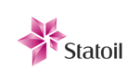
















You’re in Good Company
Banking, Financial Services and Insurance
Telecom, Media and Entertainment
Retail and Consumer Goods
Industrial and High-Tech
Energy
Health Care and Life Sciences
Services
Federal / Public Sector
Notes:
Example of our customer base
We host our own events worldwide
Over 14,000 people will be at our events this year
We go to other events in all major geographies
We are dedicated to your success
Dedicated to helping you become the best in your industry
“You’re in Good Company”
Our innovative technology, product capabilities and reputation for great support has led to global enterprise customers in every major industry vertical.

Slide 31

Broad and Diverse Use Cases for UiPath Robots
Fortune 1 and World’s Largest Company
Top robot performs the work of 160+ FTEs
Created 350,000 hours annualized
Global RPA Shared Services Multi-National Global Insurance Leader
Center
25 Entities
Worldwide Live
Consumer Credit Reporting Agency
“RPA was not a Cost Play”
3x Quality, Speed of Business, Compliance
Largest Credit Union in Florida with $8.5 Billion in Assets
Deploys robots to speed lending after Catastrophes
11x higher lending following Hurricane Irma
Largest Insurance Company in Italy
Established RPA Center-of-Excellence
12 business units enabled
Technology System Integrator
HR Robots to speed New Hire On-Boarding
80% faster
Notes:
Many different examples
Walmart
One robot alone created 350,000 hours annualized
160 full time employees
Axa
Uses to support 25 entities worldwide
Equifax
3x quality, speed of business, and compliance
Suncoast Credit Union
Used robots to help after fallout of Hurricane Irma
11x higher lending following implementation
Generali
Establishing RPA Center of Excellence
West Monroe
HR Robots sped up new hire onboarding by 80%
Walmart – speaker at UiPath Forward 2017

Slide 32

Accelerate Benefits From Digital Transformation
Jumpstart your Company’s Transformation With an Automation First Mindset
Faster Enablement
Reduced Risk
Fast Results
v
“UiPath has led to a highly visible change in the way we operate, but also in the way our employees now use their time. Instead of spending a lot of their time on manual, non-value added tasks, they can focus on higher-value, more strategic work such as providing better client service or improving compliance efforts.”
Cristian Paun
Head of Business Transformation & Procurement
Lombard International Assurance
Notes:
Accelerate Benefits from Digital Transformation
How We Do It
The UiPath platform provides the fastest path to digital transformation in customer-facing operations, enhancing the quality and consistency of customer engagement and driving extraordinary business performance benefits. Faster Enablement of Digital Transformation, Market Share Gain, Customer Acquisition: • Improved Customer Experience: UiPath’s platform can deliver and centralize customer data from a myriad of systems to allow employees to deliver improved customer experience • Increased Capacity: The UiPath platform automates through the user interface, enabling you to quickly digitize business processes and free up human capacity to focus on higher value work • Quick Build-Out: UiPath’s library features, enhanced by the Go! marketplace, provide fast, reusable, and scalable automation allowing for the realization of benefits quicker • Competitive Advantage Through Data Science: UiPath’s platform allows users to easily apply any AI technology to a process, enabling the transformation from rules-based to experienced-based automation • Future Proof: UiPath’s open platform works with today’s technology, and is extensible to handle tomorrow’s technology • Enterprise-Wide Automation Benefits: The UiPath robot can operate in both attended and unattended mode, significantly expanding the number of processes that can be automated across the enterprise • “A Robot for Every Human”: The UiPath platform’s ease of use allows business users to build and control their own automations without reliance on IT as well as work side-by-side with their robots Reduced Business Risk: • UiPath computer-vision technology ensures 100% accurate execution every-time, delivering consistency for critical customer and employee processes Fast Results: • UiPath’s automations deliver results quickly (within 6-9 months) so that businesses can redirect resources toward growth and innovation within the first year • UiPath’s partnership with customers accelerates digital transformation and protects customers’ long-term investments
Better
Industry-Leading Robots – UiPath’s comprehensive, feature rich platform, which supports attended, unattended, and hybrid automation all within the same platform, gives customers the fastest way to digitally transform across the entire enterprise • Rapid Results – UiPath’s automation design that both tech and business teams can easily understand, along with our customer success resources (UiPath Academy, UiPath Go!, UiPath Community, and UiPath Customer Success Program) typically deliver results 40% faster than our competitors • Automation at Massive Scale – UiPath’s proven, scalable, and secure architecture (e.g., multiple automation models, multi-tenancy, flexible deployment models) allows customers to scale automations across their enterprise within a single implementation, avoiding the complex IT infrastructure required by competitors • Path to AI – UiPath’s AI-enabled platform offers an open approach to incorporating AI tools at a task level, sharply increasing the speed and accuracy of results. Features of our open approach include: drag and drop AI skills, a compatible and easier way to integrate with best in breed AI technologies, and being extensible for customers to utilize their own AI directly within our platform
Proof Points
Customer References/Case Studies • < Insert Customer Name> | Problem: <Insert Customer Problem> | Solution: <Insert Solution> | Result: <Insert Tangible Results> • < Insert Customer Name> | Problem: <Insert Customer Problem> | Solution: <Insert Solution> | Result: <Insert Tangible Results>
Discovery Questions 1. Opening Questions (To Establish Credibility and Provide Relevant Insights)

Slide 33
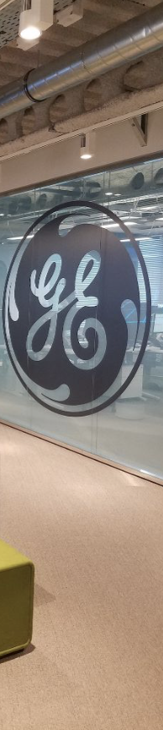

UNATTENDED ROBOTS TRANSFORM PRODUCTIVITY
ENTERPRISE RPA STORIES – BACK OFFICE
CUSTOMER: GE
IMPLEMENTATION TIME: Q2, 2016 - ongoing
PROCESSES AUTOMATED: Finance, HR, Supply Chain, IT, Legal
162
Robots deployed
150M+
From increased productivity
$28.3M
Annualized direct benefits first year
U.S. Center of Excellence is deploying RPA globally across process areas
COE dashboard allows senior leadership to see impact by geography and process type.
“GE selected UiPath for software versatility and product vision. We are going to continue pushing the limit on process automation using RPA as cornerstone.”

Slide 34


WORLD’S LARGEST HYBRID RPA IMPLEMENTATION
ENTERPRISE RPA STORIES – HYBRID RPA
CUSTOMER: SMBC Bank, Japan
IMPLEMENTATION TIME: 5 months
Compliance /risk operations
Information gathering processes used to enhance sales & planning capabilities
Support branch operations
Routine Operation Center processes
Other high volume routine operations within the Headquarter departments
¥50B
Cost reduction by 2020
3M
Hours created by 2020 (Over 1 Million today)
1,500
Target workload equivalent
200+
Operations Automated
5 SIs
Accenture, EY, Deloitte, IBM, and PwC

Slide 35


Improve Customer Experience
Make it Easier to Serve Your Customers Through Automation Technology.
Improved Customer Experience Scores
Increased Customer Confidence and Full Compliance
Reduced Customer Frustration
Speed to Deploy, Fast Enterprise-Wide Adoption
v
v
“All of our customer claims are read by UiPath robots now. Our people can focus their time on the customer instead. The power of it is exponential.”
“[UiPath Robots are] innovative, reliable, cost-effective, and they vastly improved our customer journey.”
Maura McDevit
Controller & VP
United States Postal Service
Julian McDonald
Compliance Operations Manager
Ladbrokes Coral

Slide 36


AUSTRALIA’S LARGEST MUTUAL BANK EXPERIENCES IMPROVED CUSTOMER ENGAGEMENT
ENTERPRISE RPA STORIES – BACK OFFICE
CUSTOMER: Heritage Bank, Australia
IMPLEMENTATION TIME: 2 months
PROCESSES AUTOMATED: Daily direct debit review & risk management
95%
of effort automated
98%
Manual effort reduction
6
Months to ROI
Zero
Errors reduced to 0%
12X
Faster processing time
Improved customer service, governance and compliance

Slide 37

Increase Employee Satisfaction & Engagement
Take the Robot Out of the Human
Rapid Time-To-Value
Minimizes Disruption and Errors
Fast Enterprise-Wide Adoption
Access to Training and Product Support
v
“We’ve got three boards now hanging around the office covered in praise from our customers. They’re happy, and the people on the floor — our employees — they’re happy as well. It’s a win-win.”
Karl Nolan
CEO
Generali Link

Slide 38


GLOBAL TECHNOLOGY COMPANY SIMPLIFIES HR ON-BOARDING
ENTERPRISE RPA STORIES – BACK OFFICE
CUSTOMER: Global Technology Company - USA, India & China
IMPLEMENTATION TIME: Within 2 months
PROCESSES AUTOMATED: HR Onboarding of new hires.
100%
of effort automated
100%
Manual effort reduction
6
Months to ROI
1%
Errors reduced from 30% to 1%
7X
Faster processing time
More detailed compliance and non-repudiation audit logs.

Slide 39

Reduce Compliance Cost & Risk
Mitigate, Minimize and Manage Policy and Regulatory Risk
100% Audited
Compliance through all automations
Data Consistency
v
“RPA with UiPath was not a cost play. It was more around quality, speed of doing business, and compliance.”
Jairo Quiros
VP, Global Shared Services
& RPA CoE Lead
Equifax

Slide 40


RADICALLY HIGHER ACCURACY IN PUBLIC COMPANY AUDIT DELIVERY
ENTERPRISE RPA STORIES – BACK OFFICE
CUSTOMER: KPMG Global Delivery Center (GDC)
IMPLEMENTATION TIME: Within 2 months
PROCESSES AUTOMATED: 10Q and 10K audit and validation process pre-filling (automating Footing, Cross-Footing, PY tie-outs and consistency checks)
45%
of effort automated
85%
Maximum accuracy improvement
54,000
Hours saved annually
Replaced IBM Watson which achieved only a 25%, maximum accuracy improvement
45%
Faster processing time
Natural language processing applied to textual content, extraction of tables, and validation of financial data

Slide 41

FRENCH INVESTMENT BANK STREAMLINES INTERNATIONAL PAYMENTS
ENTERPRISE RPA STORIES – BACK OFFICE
CUSTOMER: Investment Bank, France
IMPLEMENTATION TIME: Within 4 weeks
PROCESSES AUTOMATED: Sub-process of the bank’s payment system; makes international payments on behalf of client
100%
of effort automated
20%
Gain in employee’s capacity for higher value work.
11
Months to ROI
Zero
Errors reduced to 0%
90%
Processing time reduction
More detailed compliance and non-repudiation audit logs.

Slide 42


RETAIL BANK BOLSTERS ITS FRAUD PREVENTION CAPABILITIES
ENTERPRISE RPA STORIES – BACK OFFICE
95%
of effort automated
50%
of Analyst review time freed for higher value work.
CUSTOMER: Retail Bank, Greece
IMPLEMENTATION TIME: 2 months
PROCESSES AUTOMATED: Retail Fraud Prevention, a subset of the Credit Underwriting process
5
Months to ROI
Zero
Errors reduced to 0%
12x
Faster processing time
More detailed compliance and non-repudiation audit logs.

Slide 43
Link to Use Case Slides Deck
This slide is hidden
Use case slides

Slide 44


INTELLIGENT ASSISTANT SUPPORTS PORTFOLIO MANAGEMENT
ENTERPRISE RPA STORIES – BACK OFFICE
CUSTOMER: Curo Fund Services, South Africa
IMPLEMENTATION TIME: 5 Months
PROCESSES AUTOMATED: Daily closing positions, a process within Portfolio Management Systems
65%
of effort automated
35%
More capacity for higher-value work
11
Months to ROI
Zero
Error rate reduced to 0%
54%
Faster processing time
Improved governance, control. More granular compliance log files

Slide 45


AUTOMATION AMBITION AT A GLOBAL FMCG COMPANY
ENTERPRISE RPA STORIES – BACK OFFICE
CUSTOMER: Unilever, London & Rotterdam
IMPLEMENTATION TIME: 7 Months
PROCESSES AUTOMATED: P2P, O2C, R2A, SCM, MDM & Analytics across global business services lines.
85%
of effort automated
160k
Man/hours freed for higher value work
10
Months to ROI
Zero
Error rate reduced to 0%
60%
Less cycle time
Higher accuracy in maintenance prediction

Slide 46
Tear Sheet: Framing your presentation for Industry or Department Instructions for Presenter, read first then remove before presenting
The Industry vertical or Departmental horizontal solution slides are used to customize the master UiPath Customer Facing Presentation for your early conversations with customers in those specific industries or departments.
There are currently the following industry- or departmental- CFD slide inserts available:
HR | Insurance
Industries coming Q1: Banking and Financial Services, Healthcare, and Government
Horizontals coming in Q1: Finance and Accounting, Contact Center, Legal
The first section of every one of the solution CFD insert deck, – Industry Trends -- sets up industry and economic buyer challenges, and positions UiPath as understanding the customers’ industry landscape. These slides should be selected by the Seller to go into this section of the presentation.
The second section – Use Cases – provides common processes that companies in specific industries or in companies' specific departments would find beneficial to automate. This section also includes a link to the Process Heat Map for Insurance, which can be used for whiteboarding sessions to discuss which processes the customer is most interested in transforming through. This should go right after Industry Trends in this opening section
The second section – Customer Stories – selects the best case studies or public references for specific solution areas. This should normally be placed into the Customer Stories section of the CFD
The fourth and final section – Getting Started– sets up a specific call to action for your Insurance customers. This should go into the standard Getting Started section of your presentation.
Refer to the relevant Solution Battlecard in Sales Toolbox to prepare for your customer meeting, and to further guide you in customizing your customer conversation.
Notes:
DESIGN TEAM GUIDANCE: The Industry vertical or Departmental horizontal solution slides are used to customize the master UiPath Customer Facing Presentation for your early conversations with customers in those specific industries or departments. These are called "[Solution] CFD Inserts", and are available on Sharepoint in original form, and Sales Toolbox on sales-ready form.
The first section of every one of the solution CFD insert deck, – Industry Trends -- sets up industry and economic buyer challenges, and positions UiPath as understanding the customers’ industry landscape. These slides should be selected by the Seller to go into this section of .presentation. We need the Design team to apply the same designs to these decks as to the master CFD. We ALSO need the Design team to KEEP the next slide as the "tear sheet" that provides instructions to the Sales team for how to find and insert the right Industry or Department slides.
The second section – Customer Stories – selects the best case studies or public references for specific solution areas. This should normally be placed in this section of the presentation. These slides should be selected by the Seller to go into this section of .presentation. We need the Design team to apply the same designs to these decks as to the master CFD. We ALSO need the Design team to KEEP the next slide as the "tear sheet" that provides instructions to the Sales team for how to find and insert the right Industry or Department slides.
The third section – Use Cases – provides common processes that companies in a particular horizontal, or companies' specific departments, would find beneficial to automate. This section also includes a link to the Process Heat Map for Insurance, which can be used for whiteboarding sessions to discuss which processes the customer is most interested in transforming through automation.. These slides should be selected by the Seller to go into this section of .presentation. We need the Design team to apply the same designs to these decks as to the master CFD. We ALSO need the Design team to KEEP the next slide as the "tear sheet" that provides instructions to the Sales team for how to find and insert the right Industry or Department slides.
The fourth and final section – Getting Started– sets up a specific call to action for customers' specific industries or departments. This should go into the standard Getting Started section of your presentation.
. We need the Design team to apply the same designs to these decks as to the master CFD. We ALSO need the Design team to KEEP the next slide as the "tear sheet" that provides instructions to the Sales team for how to find and insert the right Industry or Department slides.
There are only 2 solution decks ready for design treatment, you can find them in Sharepoint here:
Insurance industry
HR department audience

Slide 47
About UiPath

Slide 48

Thoughts from our Founder
“
Once you apply automation to remove the mundane tasks from a person, this can bring them joy. That person becomes more valuable to the enterprise.
Daniel Dines, UiPath Co-Founder and CEO
Notes:
Over 250k Unique Free Downloads
40k+ active forum users
114k certified RPA developers across 139 countries
200k Academy members
Now we introduce….. (Can we do a separate slide on this to build suspense)
This should be a build

Slide 49
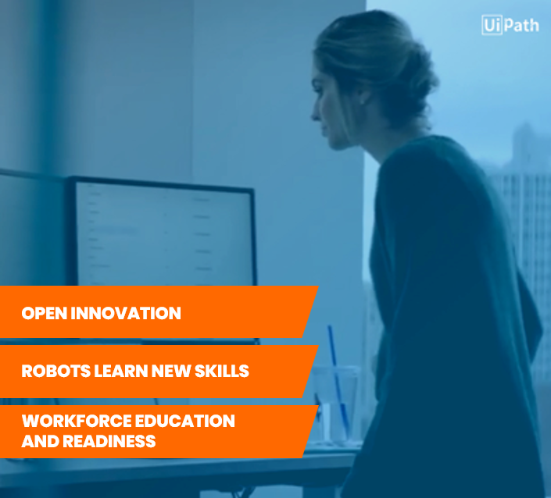
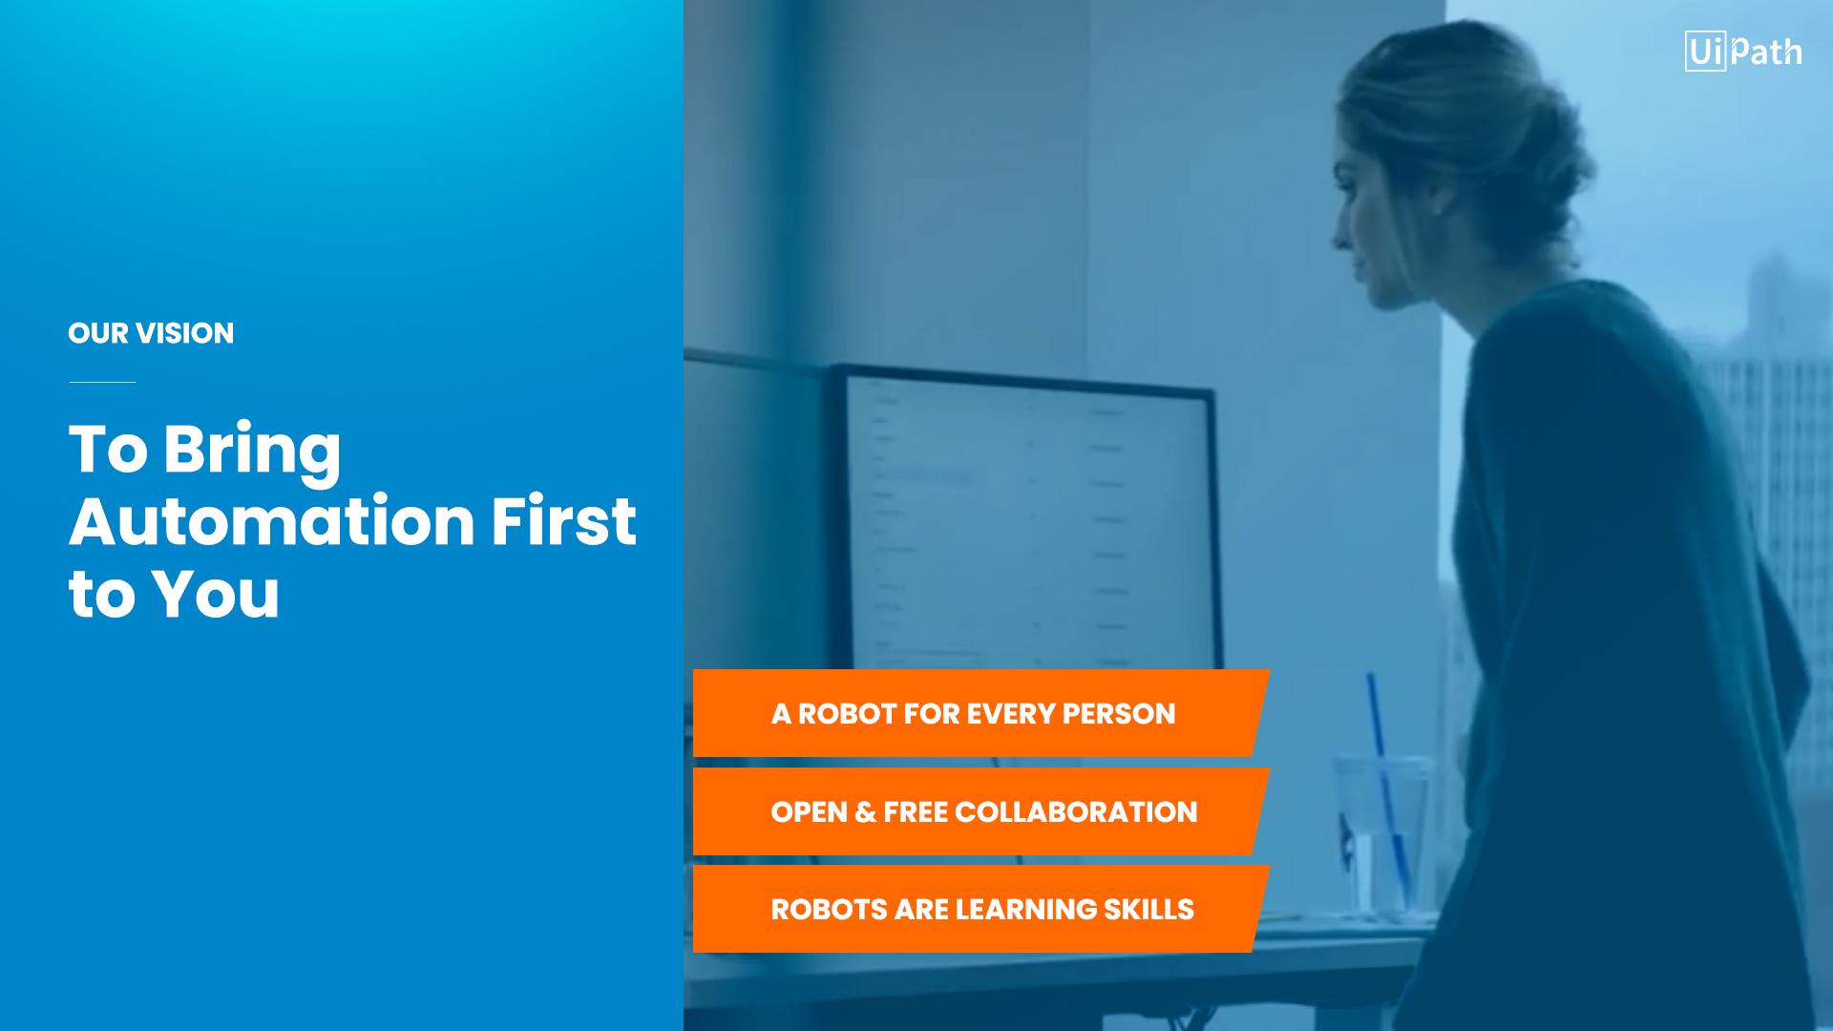

OUR MISSION
To Deliver​ the Leading RPA Platform for an Automation First Mindset​
How we will do it
OUR VISION
A Robot for Every Person
OPEN & COLLABORATIVE
ROBOTS LEARN NEW SKILLS

Slide 50





About UiPath
Fastest Growing Enterprise software company in history
Category Leader
2,100+ Enterprise customers
40+ Federal, state and local government customers
Top Sponsors
2,000+ UiPath employees
$400+M invested In Series A (2017), Series B (2018) and Series C (2018)
Notes:
UiPath track record
We are the fastest growing enterprise software company in history
1M in annual recurring revenue 19 months ago
Over 100M now
Managed growth well
Over 1,500 enterprise customers today
A number of government customers
Over 1,000 UiPath employees
Category leader by every major analyst
Our investors are the best in the world
Top minds in the world
More than the customers and software, UiPath is the best RPA company
Hoping to continue being the best for many years

Slide 51



“UiPath is proving that they have a platform that delivers value to clients incredibly fast. We believe we are now at the point where companies will start to benefit in a significant way from automation and artificial intelligence.
CapitalG is thrilled to deepen its commitment towards UiPath. We strongly believe that RPA is the main path via which organizations will take advantage of AI, and UiPath proves this potential via an unmatched growth and an incredible impact among clients.
Rich Wong
Partner
Laela Sturdy
Partner
Every company seeks to start the digital transformation of its back-end systems, and UiPath solves this sensitive point via AI-driven automation solutions. UiPath has built a technological platform that will grow the efficiency of businesses and will produce a tangible return on investment. We are thrilled to partner with UiPath to support them in accelerating their already impressive growth
Carl Eschenbach
Partner
Notes:
The view from our investors…
Another great example of why we are the best is to underscore what our investors are saying.
UiPath has best investors in the world
Accel was one of the early ones in 2017
Invested in Series A and led Series B this year
We’ve raised $183 million
They’ve noted the fast-growing enterprise RPA of UiPath
One of the fastest growing if not the fastest in history
CapitalG is venture arm of Google
Joined recently because they are excited to grow their AI and machine learning
Want to apply them to business operations
We are going to be onstage and featured heavily at Google Next conference
Kleiner Perkins is another stellar Silicon Valley firm that is an investor

Slide 52
UiPath Born Global, Operates Local 31 Offices in 19 Countries
Toronto
London
Boston
Amsterdam
Bellevue
NYC HQ
Munich
Mumbai
Austin
Paris
Bucharest
San Jose
Wash DC
Bangalore
Houston
Tokyo
A1
Dubai
Hong Kong
Seoul
Singapore
Sao Paolo
Sydney
Customer support centers in Bucharest & India
Primary UiPath Office Locations
Product development centers in Bellevue, Bucharest and India
Automation First Immersion Lab
A1
Notes:
This map changes frequently as we are always expanding worldwide
These are the offices we have worldwide
Product development centers: Bellevue, Bucharest and India
Customer support centers: Bucharest and India
Sales, marketing and RPA consultants in all other offices
Head offices at 90 Park Ave in New York City
Will be opening offices in Toronto and Sao Paulo
“UiPath Global Operations to Support Your Global Business”
We’re pleased with our customer satisfaction ratings, but also determined to do better. So, in 2018 we’ll be even closer to customers - by doubling our global offices to 14. The seven new offices are in:
Singapore
Hong Kong
Munich
Amsterdam
Washington, D.C.
Houston
Seattle

Slide 53
UiPath Born Global, Operates Local 31 Offices in 19 Countries
A1
Customer support centers in Bucharest & India
Primary UiPath Office Locations
Product development centers in Bellevue, Bucharest and India
A1
Automation First Immersion Lab
Notes:
This map changes frequently as we are always expanding worldwide
These are the offices we have worldwide
Product development centers: Bellevue, Bucharest and India
Customer support centers: Bucharest and India
Sales, marketing and RPA consultants in all other offices
Head offices at 90 Park Ave in New York City
Will be opening offices in Toronto and Sao Paulo
“UiPath Global Operations to Support Your Global Business”
We’re pleased with our customer satisfaction ratings, but also determined to do better. So, in 2018 we’ll be even closer to customers - by doubling our global offices to 14. The seven new offices are in:
Singapore
Hong Kong
Munich
Amsterdam
Washington, D.C.
Houston
Seattle

Slide 54
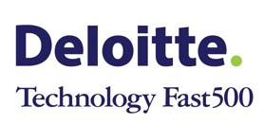


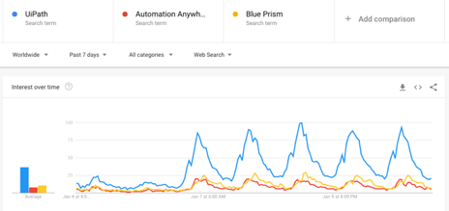
UiPath Independent Recognition
#26
#12
Best Company Culture
- 2018 -
Best Company Happiness
- 2018 -
Best Company for Diversity
- 2018 -
Best Company for Women
- 2018 -
Past Week
30,664
19,122
No Pure-Play Competitor Below 200,000
No Pure-Play Competitor Below 100,000

Slide 55
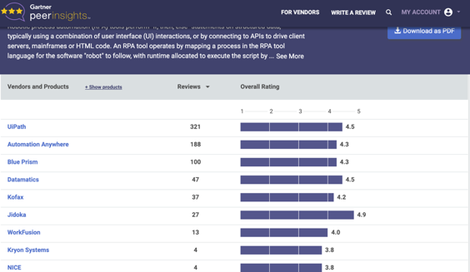
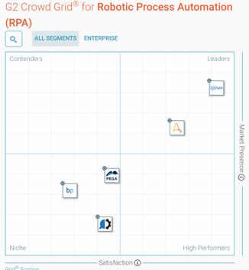
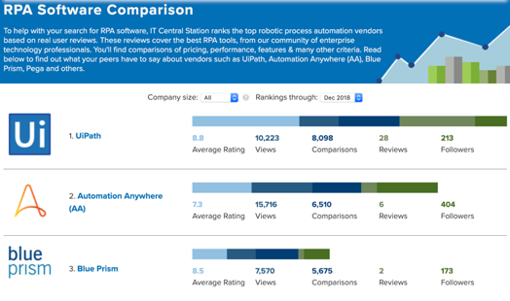
Independent User Reviews
UiPath Reviews
321 with 4.5
UiPath Reviews
236 with 4.6
UiPath Reviews
30 “in-depth”
UiPath NPS
68
Announced as Best RPA Solution of the Year (October 2018)
Announced as Top RPA Solution of the Year (January 9, 2019)

Slide 56
Commitment to Customer Success
Customer Success Manager Focus
Customer Result
Automation
Strategy
CoE
Governance
Adoption & Productivity
Robust Automations
Effective
CoE Governance
Adoption
Plan
Success
Metrics
Proper onboarding and pilot
RPA awareness throughout organization
Training program
Automation best practices are followed
Change management for code changes and application updates
Infrastructure alignment with RPA goals
Healthy tri-party arrangement (Customer, Partner, UiPath)
Reporting for business owners
Effective process selection methodology
Training
Plan
Dev Ops
Process
Partner Collaboration
Upgrade
Strategy
Notes:
A given process could take multiple forms

Slide 57
Let’s Continue the Conversation
Try UiPath Community
Get certified using Academy
Schedule a Demo
Get started with a proof-of-concept
Prioritize processes to automate
Drive extraordinary productivity gains fast
Notes:
We hope you’re encouraged by the speed and size of the outcomes
Get started today by downloading the free UiPath trial from our website
Sign up for free training with UiPath Academy on our website
Leverage our global partners
We’re happy to connect you with any partner who could help
“Let’s Continue the Conversation” Ending Title Slide

Slide 58
Appendix

Slide 59
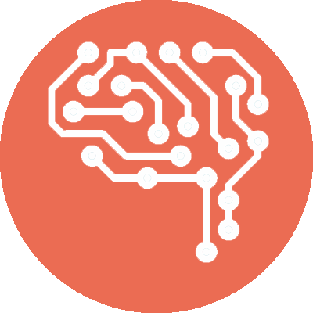
What is RPA?
[Robotic Process Automation]
Robotic automation uses a software robot to run application software in the same way that a person works with that software
Automation that interacts with a computer-centric process with a software User Interface providing support
RPA
RPA configures software that will automate the activities or tasks previously performed by humans
RPA aims to replace repetitive tasks performed by humans, with a virtual workforce. Humans then make judgmental calls, handle exceptions and provide oversight

Slide 60











How can RPA help me?
The Case for Enterprise RPA,
BETTER CUSTOMER EXPERIENCE
ELIMINATE REPEAT WORK
RAPID ROI
ENHANCED PROCESSES
IMPROVED SERVICE
DELIVERY
ENHANCED ABILITY
TO MANAGE
INSIGHTS AND ANALYTICS
COST REDUCTION
NON-INVASIVE TECHNOLOGY
INCREASED COMPLIANCE
SCALABILITY AND FLEXIBILITY

Slide 61

RPA: Adoption Trends
RPA is a low-risk, fast-win business proposition. No wonder the accelerated growth.
If adoption continues at its current level, RPA will have achieved near-universal adoption within the next five years.
The time to act is now.
The Enterprise RPA Market
$2,900M
63% CAGR
5-year CAGR
$250M
2016
2017
2018
2019
2020
2021

Slide 62

Built on a Decade of Breakthroughs
2005
2010
2015
2017
DRIVERS
Screen Scraping SDK
X32/64 Agnostic
Intercept Synchronous / Async Events
Generalized Selectors
Background Automation
Smart Selectors
Relative Selectors
AUTOMATION
Text Automation
WWF - Open, Modular UI Automation
Surface Automation
Anchoring
Object Classification
Simple Recording
Terminal Apps
ORCHESTRATION
Nugget workflows and activities
Multitenancy
Queues, schedules, user, roles, management, release management
Invoke Code
Cognitive Activities
Multiple Terminal Sessions
Notes:
“Built on a Decade of Breakthroughs”
As we spoke of earlier, UiPath’s compelling differentiators aren’t based on two or three features. Rather, they come from a myriad of features developed over the past ten years - all inspired by listening to our customers.

Slide 63


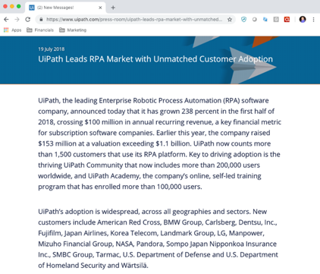

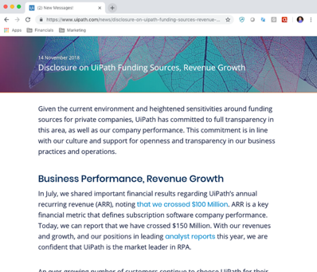


UiPath Business Practices
Open and Transparent Business Practices
Top Tier Board, Investors and Advisors

Slide 64
A Deep Dive in Finance and Accounting for Enterprise RPA
Accounting
Accounts payable
Accounts receivable
Automating complex journal entries
Performing and documenting account reconciliations
Calculating and applying allocations
Maintaining fixed-asset accounts
Entering non-EDI invoices
Performing 2- and/or 3-way invoice matches
Processing expense-approval requests
Completing audits (eg. Duplicate supplier payments)
Generate and validating invoices
Applying cash to outstanding balances Analyzing and processing disputes
Creating reports (eg. Accounts receivable aging, credit holds)
Financial planning and analysis
Payroll
Other
Building standard management reports Consolidating and validating budget and forecast inputs
Gathering and cleaning data for analysts
Flagging time-sheet errors and omissions
Auditing reported hours against schedule
Calculating deductions
Harmonizing data across multiple time-keeping systems
Preparing external-reporting templates
Conducting transaction audits of high-risk areas
Preparing wire-transfer requests
Source: McKinsey&Company
Notes:
Starting point is critical
What are the key starting points where most companies begin their RPA journey?
Finance and Accounting
This is a great slide from McKinsey & Company
These are the tasks that we see where RPA could easily play in
Our Chief Customer and Success Officer, Ashim Gupta, came from GE
He says that every CFO should look at their finance organization and if they’re not doing data driven analytics all day, then automate with RPA
Here is a number of areas where there are opportunities for RPA
Thoughts: Talk about how after initial robots in back office or finance prove them selves you can go built a COE or just a shared service RPA group that can then extend into . Might be good to show actually progression. Single robot or two. >. COE. > multiple business units have robots..>. Extends across company and robots help all parts of business.

Slide 65
Attended use cases for UiPath Robots
Investment Bank
100% manual international payment process in their Retail Payment department.
HR onboarding process of new hires, transfers and departures with increased volumes.
Strengthened KYC (Know Your Customer) fraud prevention capabilities for a leading retail bank.
Notes:
Walmart – speaker at UiPath Forward 2017

Slide 66
Enterprise RPA in 3 Steps
1
Proof of Concept
2
Pilot
3
Roll-Out
(6–10 weeks)
(Depends on scope)
(3–6 weeks)
UiPath develops a solution on a selected process within 30 days to demonstrate the power of automation.
On approval of proof of concept, we develop additional automated processes and create a governance and roll-out plan.
Full roll-out of all relevant business processes and handover to the customer.
Notes:
Proof of concept
We recommend that everyone spend time touching the robots
Make something with the software
Have colleagues work with it too
Pilot
Have full governance to try a plan
Get everyone involved
Deployment
Full scale
Deploy over an area that you want to automate
We commonly see people skip step 2
This is fine, shows speed at which RPA moves within a company
Enterprise RPA in 3 Steps”
Engaging a UiPath implementation partner is a popular choice for many of our customers, but it isn’t a necessary one. We’re committed to the success of every customer and offer support from proof of concept to a sustainable deployment.
Our support covers these three RPA implementation steps:
Proof of Concept: this step answers the question, “Will RPA really show the benefits I’ve heard about for one of our own processes?” In 2015 -16, almost every customer went through this step.
During 2017, almost half skipped this step and went straight to Pilot, believing the odds of a positive PoC were so high it would only waste valuable time. It turned out to be accurate - no one regretted the decision.
Pilot: This step requires the organizational commitment for an:
Executive champion
Project Manager/Evangelist
Steering committee with IT, business and (when possible) process improvement/Six Sigma representatives
Budget for initial hiring and training of core RPA resources.
The UiPath Customer Success team supports:
Initial hiring and training
Creation of governance, organizational, implementation frameworks
Deployment of the UiPath Platform across Dev, Test & Prod environments
Identification, evaluation, prioritization and automation of initial processes
Automation reviews and lessons learned
Roll-out: this step is typically taken with the customer and UiPath agree that:
Hiring and training have met all objectives.
Pilot automation outcomes demonstrate consistent success.
Frameworks are clearly operational and have formed either a Center of Excellence or its equivalent.
There is a healthy pipeline of well qualified automation opportunities.
The organization shows a strong level of RPA enthusiasm
Post-Rollout: Customer success holds weekly calls and an on-site visit schedule until such time as both the customer and UiPath agree sustainability has been achieved.

Slide 67
Building Your Center of Excellence
UiPath and our partners ensure your organization strategically leverages Enterprise RPA to its fullest potential
General
Functional
Technical
People
Centralized knowledge management
Standardization of policies and procedures
Centralized vendor relationship management and support
Governance
Specific RPA application functional knowledge
Automation process expertise
Support and coordination of RPA related metrics and scorecards
Connectivity and infrastructure
Robot configuration
Robot maintenance & support
Database maintenance and support
Help desk support
RPA technical support
Training and development
Communication
Change management
Notes:
Spend time understanding how to build a Center of Excellence
This is critical for maintaining automations as certain things change
Things have to be updated
Our partners have UiPath COE’s also
Centralized knowledge management
Functional, Technical and Human support
Lots of organizations within UiPath that can help build a COE
“Building Your Center of Excellence”
Whether our customers move forward with an implementation partner or the Customer Success team, they are strongly encouraged to implement a RPA Center of Excellence.
CoE: isn’t necessarily the difference between success and failure, but it is typically the difference between rapid success and a much longer implementation timeline. Given RPA’s compelling cost and operational, time shouldn’t be wasted.
The CoE delivers these four pillars of operational support. One of its most important benefits is the focus it brings to governance, support (production & customer) and change management. All of which are essential for sustainability.

Slide 68
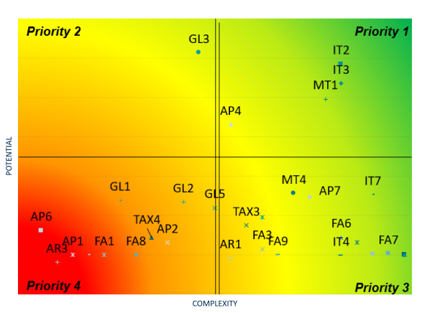
Identifying Your Pilot and Next Best Automations
Create a “heat map” of the automation potential across the organization
Choose your first process to pilot
Rinse and repeat
ROI
Skillset
Champions/ Culture

Slide 69
RPA Team and Governance
Level 1: Strategic Governance
Executive steering committee
Provide company leadership and strategic direction led by the c-level suite
The committee will set the RPA strategy and goals for automation across the company on a quarterly and monthly level
The goal of the operational governance team is to implement the RPA strategy and support overall governance
Bi-weekly meetings track and report on performance, tasks, issues, and risks
Key goals of the tactical governance team include quality management, including SLA monitoring, knowledge sharing, and facilitating communications
Weekly meetings are the first level of escalation to review automation pipeline, tasks, issues, risks, etc.
Level 2: Operational Governance
COE leads
Level 3: Tactical Governance
Senior RPA COE technical and business resources, IT, BU / Functional Leaders, HR
COE team members

Slide 70
Winning Support Within the Organization
Identifying main stakeholder groups within your org:
Senior Management
Line-of-business Managers
Employees
Support from executives is critical
Give them access to marketing collateral
provide regular reporting to demonstrate progress and highlight results
Have business-unit responsibility but also maintain productive relationships with direct reports
Helping them understand exactly what RPA will and won’t do
Change management - alleviating employees’ concerns that robots are coming for their jobs
Convert skeptical employees into project advocates
Great source of process pipeline

Slide 71
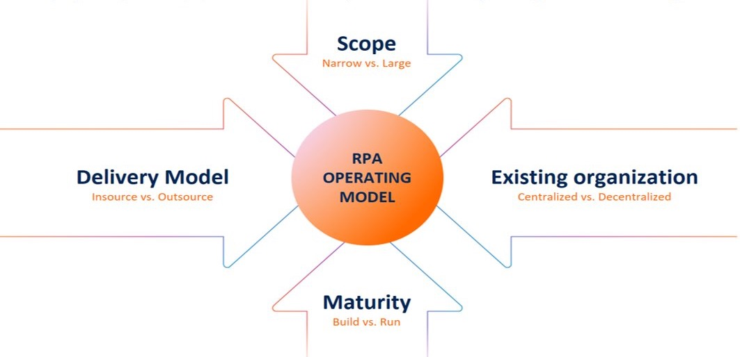
Building your operating model…

Slide 72
Scaling RPA
The start of the journey includes POCs, pilots and first automations
~10 Bots
Digital workforce transforming the way we organize & work
“A robot for everyone”
~1,000 to 40K Bots
Functioning operating model with strong opportunity pipeline
~200 – 1K Bots
Working cross-borders and integrated with distributed ledgers
~TBD Bots
4
3
2
1
Start
RPA at Scale
Digital Workforce
“Gigabot” Economy

Slide 73

Measuring Success
Automated Processes SLAs
Monitors the performance of automated processes in terms of total efficiency created establish and monitor SLA
Virtual Workforce
Capacity KPIs
Monitors RPA virtual workforce capacity and optimization potential
PERFORMANCE
FRAMEWORK
Financial KPIs
Monitors the financial benefits and associated costs obtained from an RPA program implementation
Employee KPIs
Monitors employee development within the CoE, enabling assessment regarding department structure, resource availability etc.

